Slide 1
Product images for presentations
Eva Bryderup
MarCom Manager

Slide 2
Evosep (https://www.evosep.com/media/)
COMPANY BIO (50 WORDS)
Evosep aims to improve quality of life and patient care by radically innovating protein based clinical diagnostics. Making sample preparation and separation before MS analysis 10 times faster and 100 times more robust will enable truly large cohort studies for biomarker validation and provide the foundation for precision medicine.
COMPANY BIO (25 WORDS)
Evosep aims to make clinical proteomics 100 times more robust and 10 times faster by radically innovating sample preparation and separation prior to MS analysis.

Slide 3
Evotip
Evotips are essentially miniature, disposable trap-columns.
Samples are loaded onto Evotips for de-salting and cleaning prior to separation on the Evosep Eno system.
The loading and cleaning steps are thus done off-line and may be automated or done in parallel with multi-channel pipettes.
Sample preparation is therefore extremely fast.

Slide 4
Evotip

Slide 5
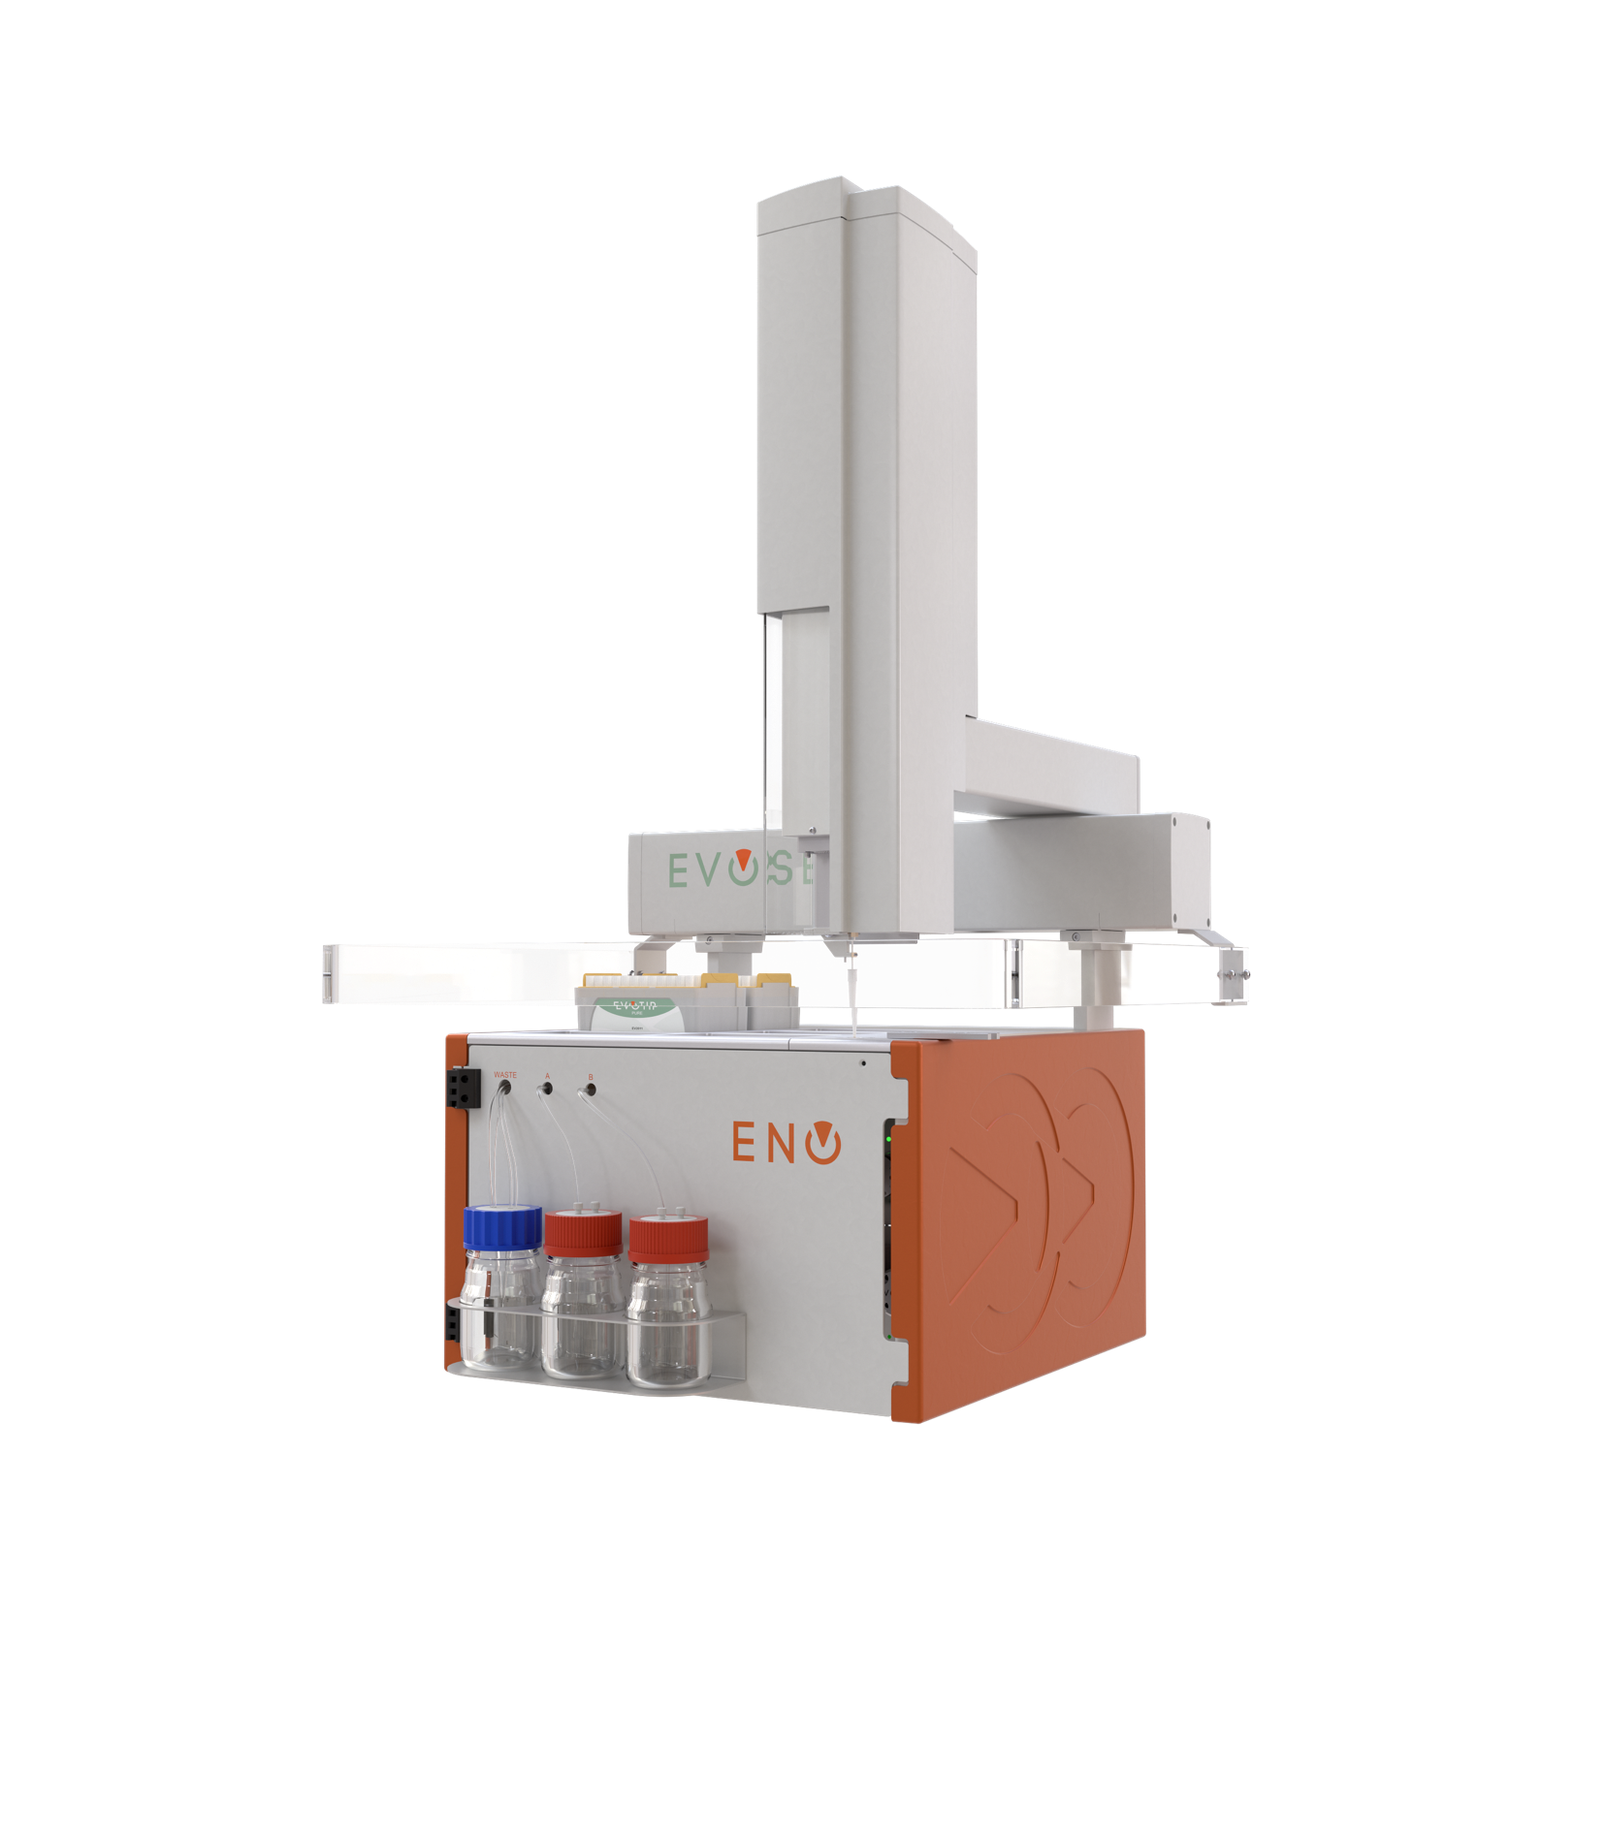
Evosep Eno
Evosep Eno is an easy-to-use, robust and reliable chromatographic solution for high performance and standardized proteomics, preparing for next generation workflow integration.
Evosep Eno supports short runs, with less than 4 minutes system overhead between runs. In order to maintain highly sensitive, yet robust analysis, the column diameters does not exceed 150μm.
Evosep Eno uses disposable trap columns (Evotips) with the samples preloaded to minimize cross contamination in complex matrixes such as plasma or urine samples. Evotips enable sample loading to be automated during the sample preparation workflow.

Slide 6
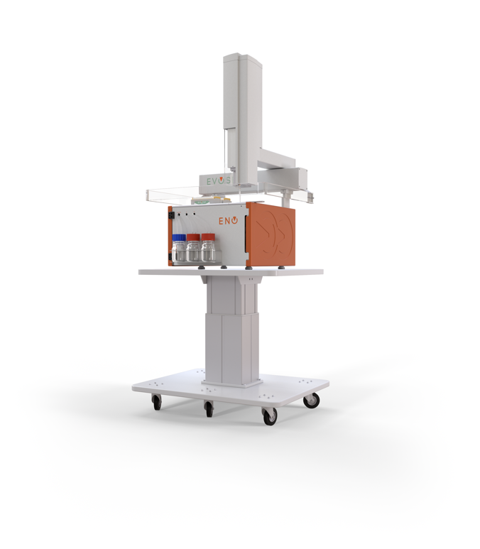
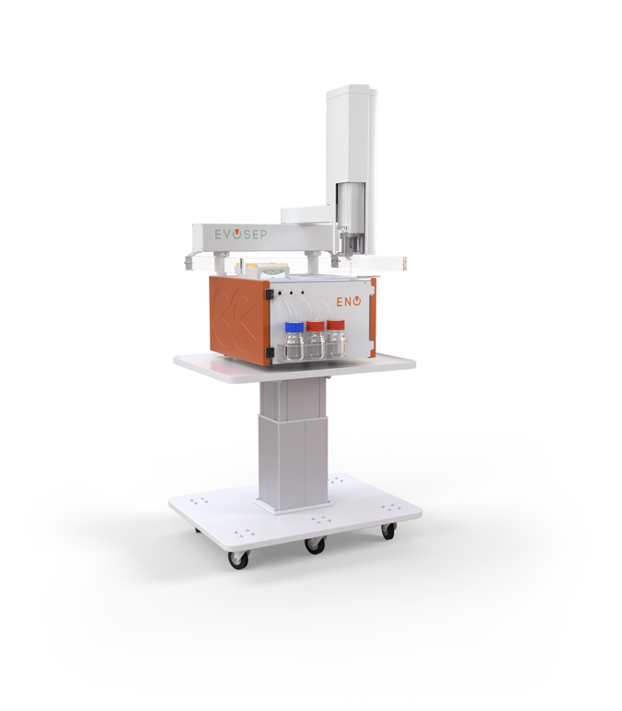
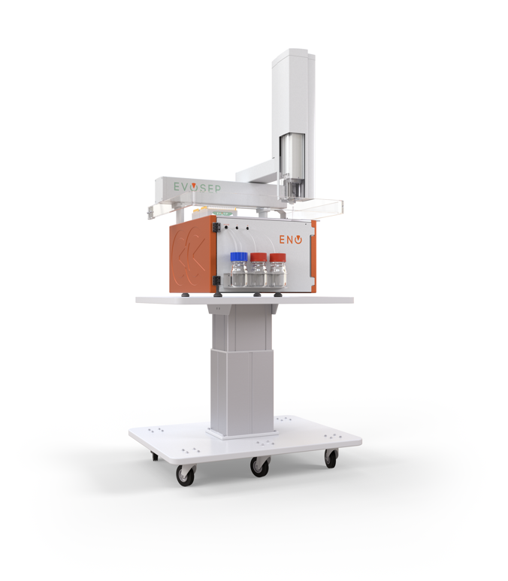
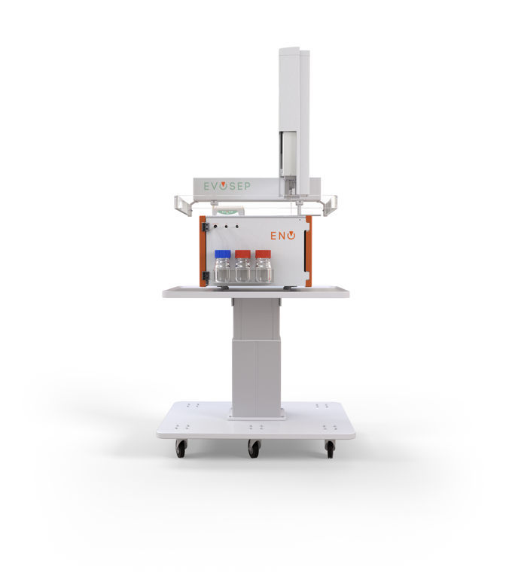
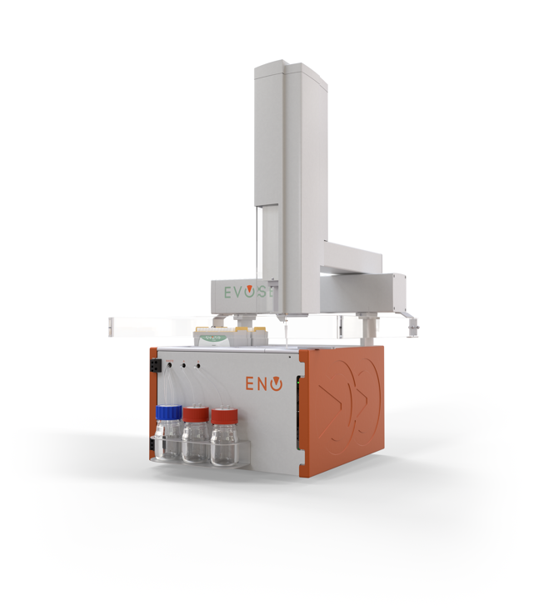
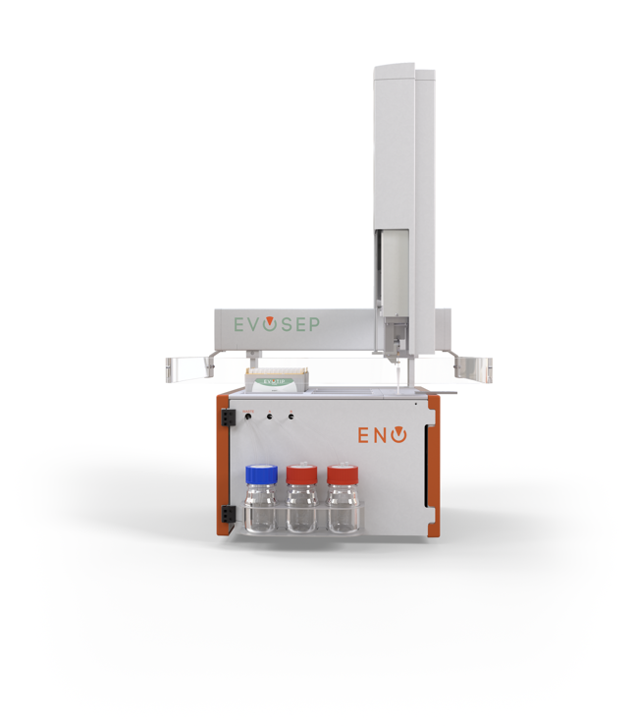
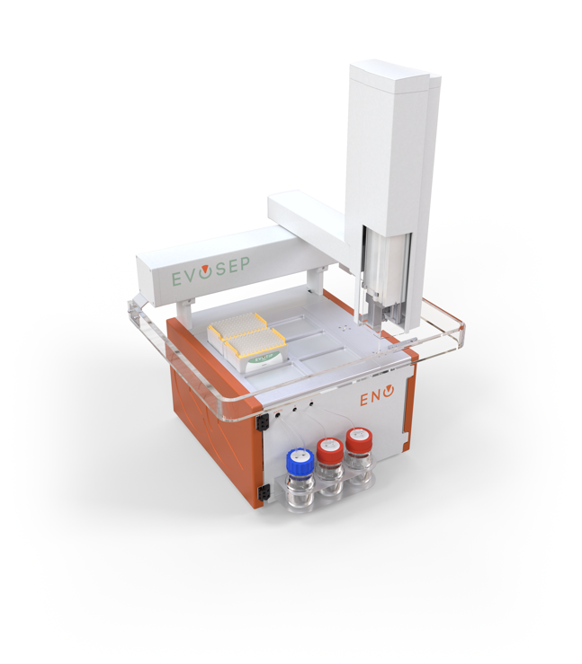
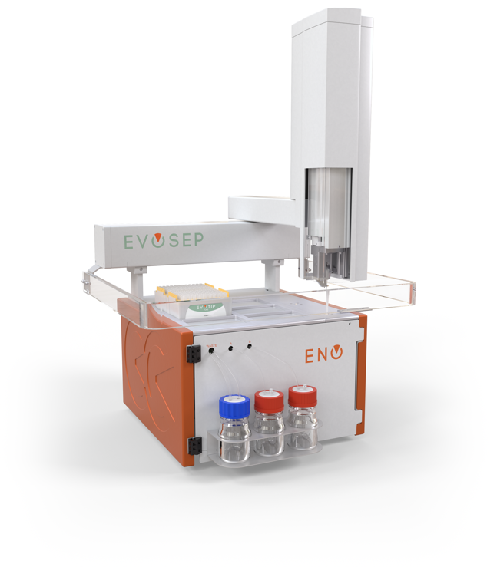

Slide 7
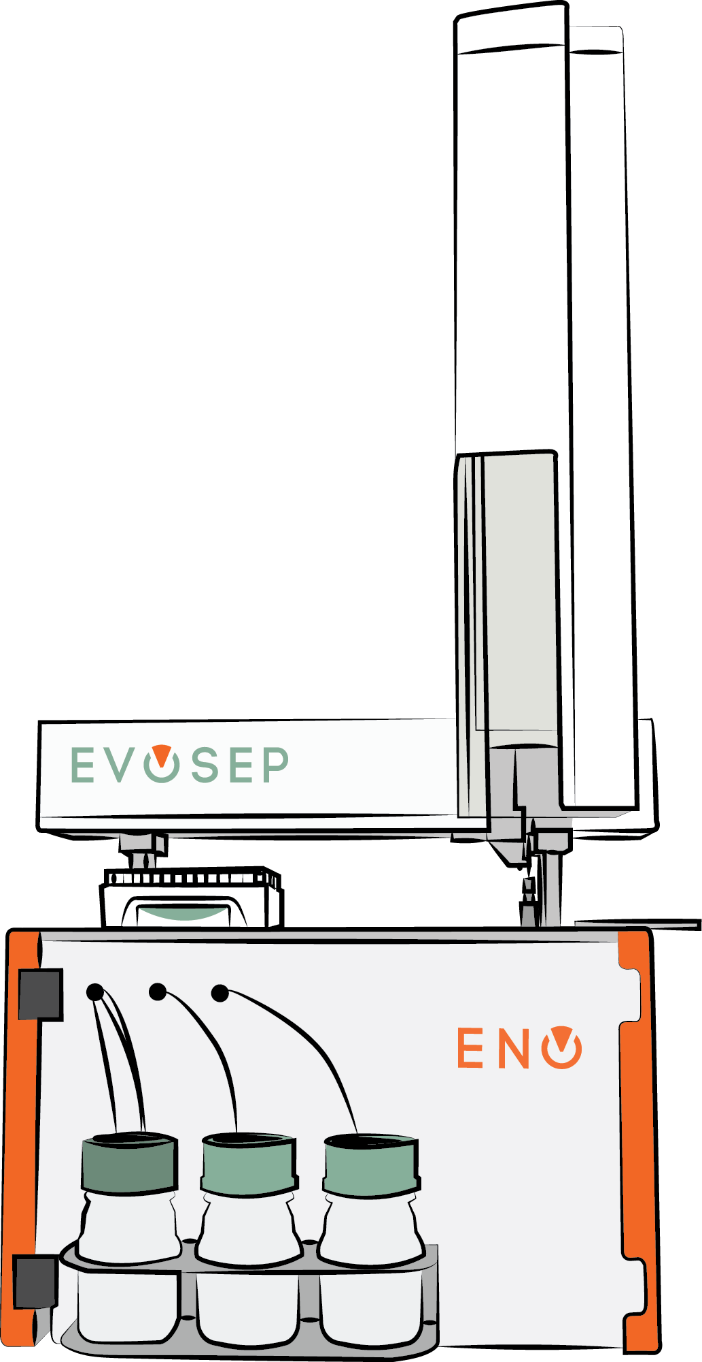
Evosep Eno - drawings

Slide 8
Photos

Slide 9
photos

